Slide 1

Sentiment analysis and hotel reviews
Mikko roimaa
Miika pernu
Pilvi tunturi

Slide 2
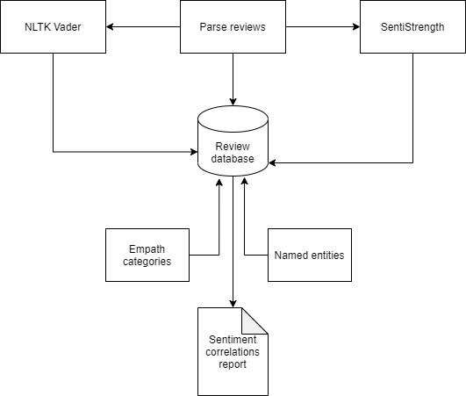
Abstract
This project aims to investigate the sentiment and test various architecture for argumenting the sentiment polarity (positive, negative, neutral) of hotel reviews. We will compare SentiStrength and NLTK Vader sentiment analysis tools and contrast evidence from individual raters.
We will compare how these tools are able to correlate the sentiments of user’s reviews. We will study what are the strengths and weaknesses of those tools and how do they perform overall compared to each other. We will analyze what kind of categories relate to each review and how do they correlate to positive or negative sentiments. We will also investigate what kind of named entities each review has and how do their presence correlate to the positive or negative sentiments.
Several hypothesis will be tested. Firstly hypothesis on the relation of argumentation on positive and negative sentiments. Secondly we will test hypothesis related to review ambiguity. Are ambiguous reviews shorter or do they have bad readability.
Notes:
Parse reviews instead of gather
Repeat 10) when we would to test the hypothesis that ambiguous reviews are likely to be short. So, construct a vector containing the cardinal of each review report and see whether the above claim is sustainable.
We would like to see to test the hypothesis that ambiguous reviews have bad readability. For this purpose, consider the Automated readability Index, which expresses the Readability of review as 4.71(#characters/word) + 0.25( #words/Sentence)-21.43. This is already implemented in python Textstat library https://pypi.org/project/textstat/. Calculate the automated readability index for each review and add it to database D. Then, test whether poor readability value entails high probability to belong to ambiguous class.

Slide 3
Relevant prior work
Relevant prior work (paper citations, actual systems)
1. https://drops.dagstuhl.de/opus/volltexte/2016/6008/pdf/OASIcs-SLATE-2016-3.pdf Comparing the Performance of Different NLP Toolkits in Formal and Social Media Text∗
2. https://www.researchgate.net/profile/Ammar_Hassan6/publication/273000042_Benchmarking_Twitter_Sentiment_Analysis_Tools/links/54f484d70cf2ba6150634593.pdf
3. https://hci.stanford.edu/publications/2016/ethan/empath-chi-2016.pdf empath: Understanding Topic Signals in Large-Scale Text/11
4. https://www.cs.uic.edu/~liub/publications/kdd04-revSummary.pdf Mining and Summarizing Customer Reviews
5. https://www.win.tue.nl/~aserebre/ICSME2015ERARobbert.pdf Choosing your weapons. On Sentiment Analysis Tools for Software Engineering Research and On negative results when using sentiment analysis tools for software engineering research https://link.springer.com/article/10.1007/s10664-016-9493-x
6. http://www.lrec-conf.org/proceedings/lrec2012/workshops/21.LREC2012%20NLP4UGC%20Proceedings.pdf#page=20 Challenges in developing opinion mining tools for social media
7. https://books.google.fi/books?hl=fi&lr=&id=v0UBEAAAQBAJ&oi=fnd&pg=PR11&dq=sentiment+analysis+research+papers+2020&ots=UfD_z38JxN&sig=M0Elv2d3siwkAmMjnz-mX9J_juU&redir_esc=y#v=onepage&q=sentiment%20analysis%20research%20papers%202020&f=false Sentiment analysis
Notes:
Comparison of the toolkits aims to find out what kind of tools to use to which kind of texts. Obviously there are plenty to choose from but choosing is not obvious. What are the aspects that one must consider? Among other aspects, the selection may consider the community of users, frequency of new versions and updates, support, portability, cost of integration, programming language, the number of covered tasks, and, of course, their performance. The study concentrates on default configuration.
2. Is benchmarking twitter sentiment analysis tools. It finds out that the accuracy or performance varies a lot from the average 66-70% accuracy to a low accuracy less than 50%. Study reveals the importance of choosing the tool and what kind of trade offs will be made.
3. How does empath work and what are it’s tradeoffs.
4. Not sure if this one is important, but might be
This seems to emphasize the importance of knowing the tool you choose for which use case.
5. This study aims to find out how do the current tools work on different domains, like software engineering.

Slide 4
Topics investigated
Getting to know different tools
Sentiment analysis
Categories
Named entities
Data visualization

Slide 5
Project overview
Group member responsibilities:
Miika: Team lead, Data visualization, GUI, SentiStrength
Mikko NLTK Vader, Textblob, empath categories,
Pilvi: Named entities, prior work investigation, AWS Comprehend
Data sources:
https://www.kaggle.com/datafiniti/hotel-reviews (Datafiniti_Hotel_Reviews_Jun19.csv)
WordNet or Merrium dictionary
Technologies used and existing tools leveraged:
Python (Jupyter notebooks)
AWS Comprehend
SentiStrength
NLTK Vader
Textblob
Empath client
QT (GUI)
Textstat library

Slide 6
Current results so far
Tools have been investigated
Database and workflows have been designed
Scripts are in GIT ready to be used for further analysis
…

Slide 7
To do
Named entities to files
Update GUI
Create report
Hypothesis testing
Analyse results
W43
W44
W45

